Slide 1
The Simultaneous Detection and Classification of Mass and Calcification Leading to Breast Cancer in Mammograms
Scott Gozdzialski, Ireti Fasere, Alex Stern
Advisor: Daniel Engels

Slide 2
Talking points
Introduction
Results
Ethics
Conclusion

Slide 3
Abstract
Problem: The Simultaneous Detection and Classification of Breast Caner in Mammograms
Solution: Convolutional Neural Networks
Result 46% accuracy of detection with 64% properly classified

Slide 4
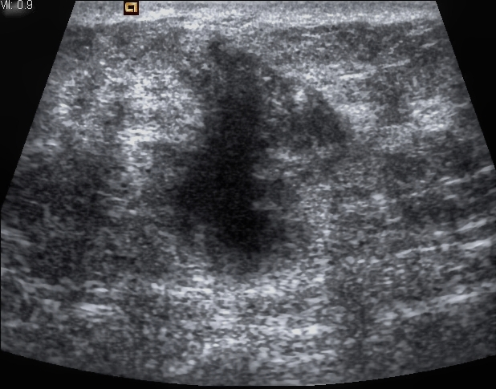
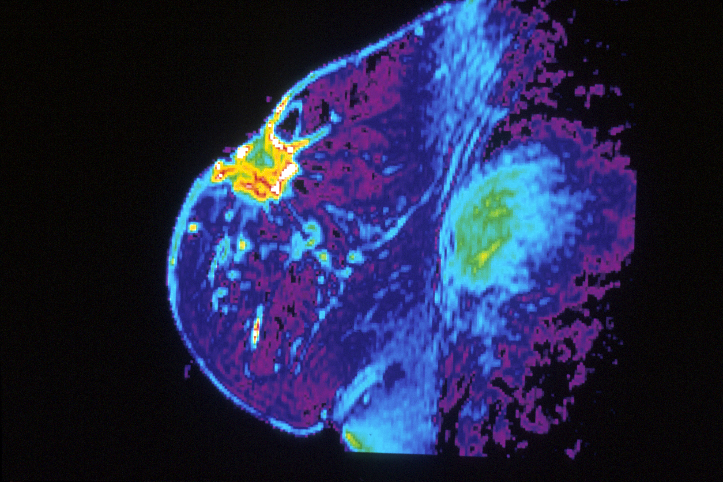
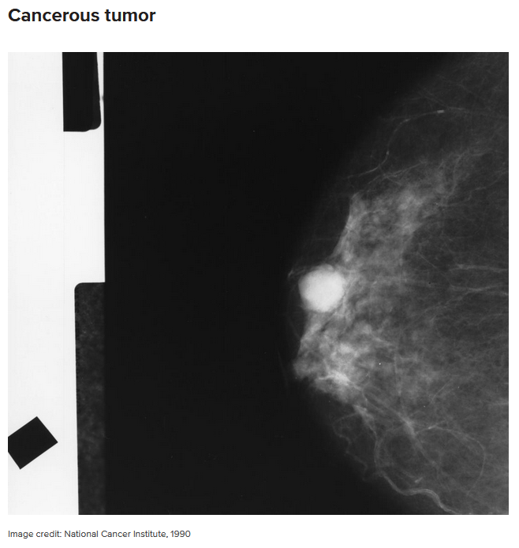
Introduction: Breast Cancer
1 in 37 Women die of breast Cancer, 2.7%
Types: Mass/Calcification Pathology: Benign/Malignant
Tools: Physical exam, Imaging, and Biopsy.
Imaging types: Mammogram, MRI, Ultrasound.

Slide 5
Introduction: Breast Cancer
1 in 37 Women die of breast Cancer, 2.7%
Types: Mass/Calcification Pathology: Benign/Malignant
Tools: Physical exam, Imaging, and Biopsy.
Imaging types: Mammogram, MRI, Ultrasound.

Slide 6
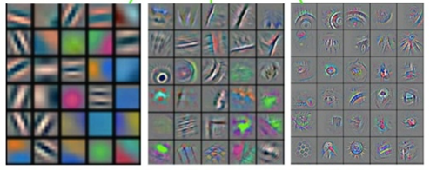
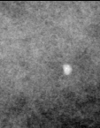
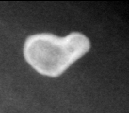
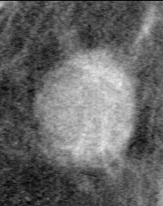
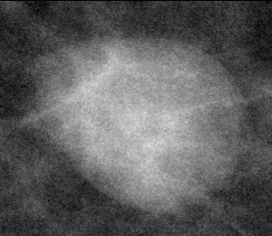
Introduction: Convolutional Neural Network
Classifier of the four Type/Pathology
Curated Breast Imaging Subset of DDSM
100 Full Mammograms for Object detection
2866 images for Training
744 images for Validation

Slide 7
Introduction: Convolutional Neural Network
Classifier of the four Type/Pathology
Curated Breast Imaging Subset of DDSM
100 Full Mammograms for Object detection
2866 images for Training
744 images for Validation

Slide 8
Introduction: Convolutional Neural Network
Classifier of the four Type/Pathology
Curated Breast Imaging Subset of DDSM
100 Full Mammograms for Object detection
2866 images for Training
744 images for Validation
Biased dataset – All images contain cancer

Slide 9
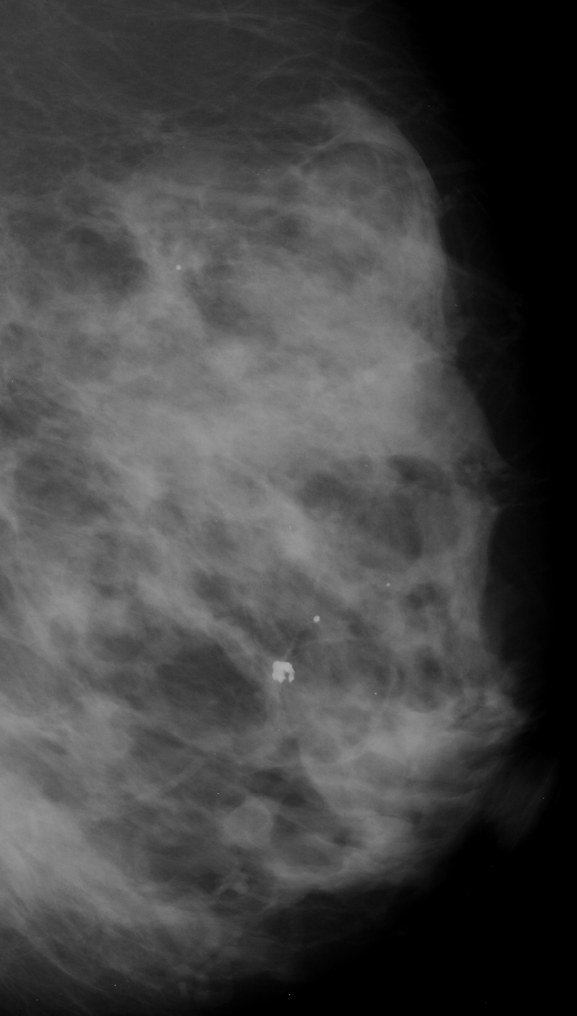
Introduction: Convolutional Neural Network
Object detection
Sliding window detector

Slide 10
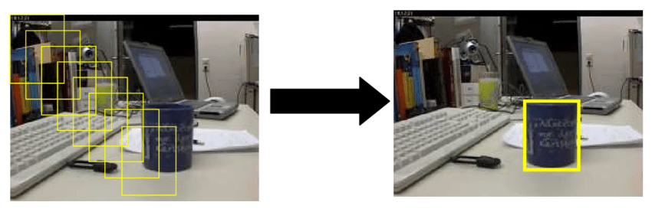
Introduction: Convolutional Neural Network
Object detection
Sliding window detector

Slide 11
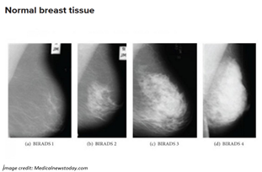
Background: Mammogram
X-Rays of the Breast
Normal Mammogram

Slide 12
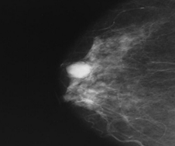
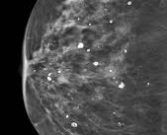
Background: Mammogram
X-Rays of the Breast
Abnormal – Mass
Abnormal - Calcification

Slide 13
Background: Mammogram
Interpretations
BI-RADS
Category | Interpretation
0 | Result unclear, needs further test, and previous mammogram comparison
1 | Abnormalities absent
2 | No cancer but presence of abnormalities like benign calcifications
3 | Abnormalities like benign present needs follow-up
4 | Abnormalities present could be cancerous, may need biopsy
5 | Abnormalities present likely to be cancerous, requires biopsy
6 | Presence of cancer requires a mammogram for progress.

Slide 14
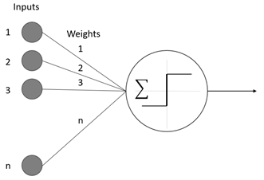
Background: Neural Networks
Built upon the Perceptron
Takes in many inputs
Has one output

Slide 15
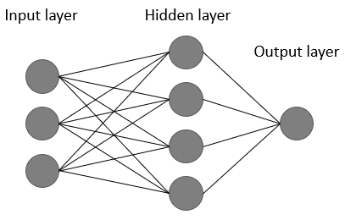
Background: Neural Networks
Each Layer
Takes in many inputs
Can have one or more hidden layers
Can have one or more outputs

Slide 16
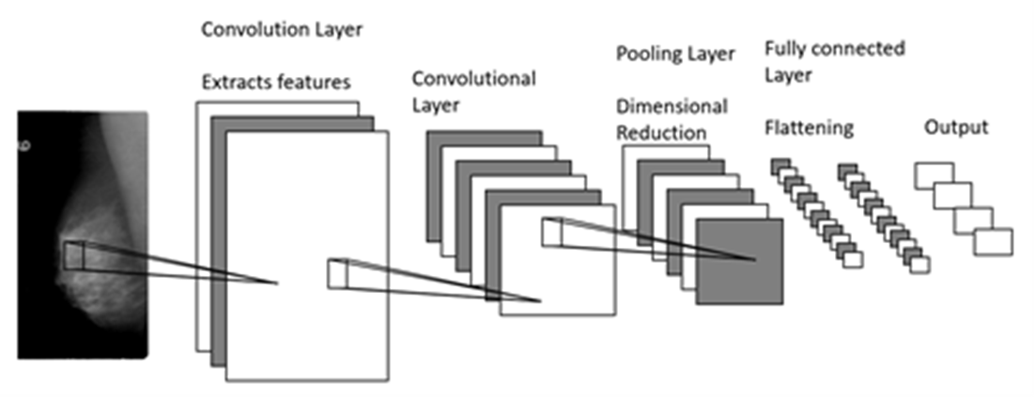
Background: Neural Networks
Convolutional Neural Network
Uses layered approach

Slide 17
Background: Neural Networks
Convolutional Neural Network
Convolutional Layer applies filters
Pooling is used to reduce computational complexity
Drop out reduces overfitting by hyperactive neurons
Fully connected layer transform network results to the final output

Slide 18
Background: Neural Networks
Object detection
Sliding window detector

Slide 19
Background: Data
Curated Breast Imaging Subset of DDSM
Breakdown,
100 Full Mammograms for Object detection
2866 images for Training
744 images for Validation

Slide 20
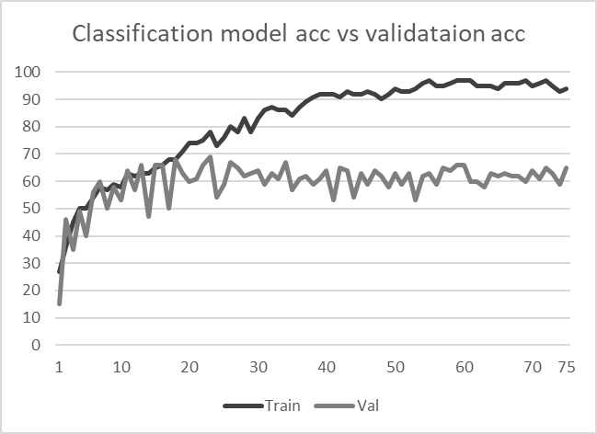
Method
Four Fully connected Convolutional layers (10 - 80 Filters per layer)
One Flattening layer
One Pooling layer

Slide 21
Method
75 Epochs (Iterations)
Peaked at 68% Classification /Validation Accuracy

Slide 22
Results
46% Detection rate
20% Calcification
26% Masses
17% Benign
29% Malignant
64% Classification rate
2% Wrong type
34% Wrong Pathology

Slide 23
Results
46% Detection rate
20% Calcification
26% Masses
17% Benign
29% Malignant
64% Classification rate
2% Wrong type
34% Wrong Pathology

Slide 24
Ethics
Responsibility for False Positives/Negatives
Current Computer Aided Detection tools have a false positive rate of 1 in every 2 mammograms, while breast cancer is only found in 4 out of every 1000 cases.

Slide 25
Ethics
Responsibility for False Positives/Negatives
Current Computer Aided Detection have a false positive rate of 1 every 2 mammogram, with breast cancer only being found 4 every 1000.

Slide 26
Ethics
What is found?
2013 Study found that using Computer Aided Detection found a 17% increase in ductal carcinoma in situ (a non-invasive Stage 0 cancer) diagnosis with only a 6% increase in early stage invasive cancer diagnosis

Slide 27
Ethics
What is found?
2013 Study found that using Computer Aided Detection found a 17% increase in ductal carcinoma in situ (a non-invasive Stage 0 cancer) diagnosis with only a 6% increase in early stage invasive cancer diagnosis

Slide 28
Ethics
Is it a tool or a crutch?
Massachusetts General Hospital in Boston studied 107 radiologist who used and did not use CAD and found doctors who used CAD missed more cancer than those who did not.

Slide 29
Ethics
Is it a tool or a crutch?
Massachusetts General Hospital in Boston studied 107 radiologist who used and did not use CAD and found doctors who used CAD missed more cancer than those who did not.

Slide 30
Future Works
Utilize more cutting edge CNNs (ResNet)
Developing a system to use Medical images without converting them first
Using a multi-discipline team

Slide 31
Conclusion
Our method shows promise in efficiently and effectively solving the problem of simultaneously identifying and classifying mass and calcification in breast cancer
Random chance of finding the location of cancer in a mammogram is 1 in 181 or 0.005%
Other Studies have achieved 83-97% detection when looking for only one type of cancer (mass/calcification).

Slide 32
Conclusion
Our method shows promise in efficiently and effectively solving the problem of simultaneously identifying and classifying mass and calcification in breast cancer
While our model works well with images containing cancer, we cannot generalize to non-cancerous images without further evaluation

Slide 33
Conclusion
While our model works well with images containing cancer, we cannot generalize to non-cancerous images without further evaluation
This approach is an important step in the future direction of breast cancer detection and classification. As we continue to develop the model, we will eventually be able to put it to use in a broader, non-controlled environment including cancer free imaging.

